Slide 1

SKIN CANCER Detection
Team ELON
SAYAK DAS (RA2011026010101)
ROOPAL SOOD (RA2011026010103)
VIABHAV SHARMA(RA2011026010106)
Section – Q1

Slide 2


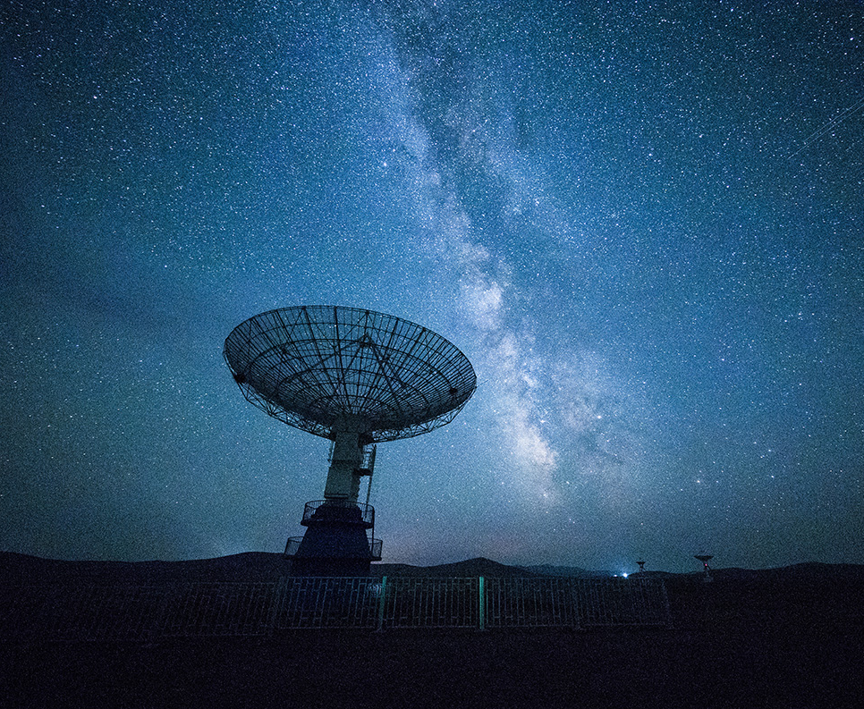
INTRODUCTION
Melanoma is a type of skin cancer that can be deadly if not detected early. It accounts for 75% of skin cancer deaths. A solution which can evaluate images and alert the dermatologists about the presence of melanoma has the potential to reduce a lot of manual effort needed in diagnosis.

Slide 3
ABSTRACT
There are mainly 4 types of skin cancers detected as of now –
Basal cell Carcinoma
squamous cell carcinoma
Melanoma
actinic keratosis
We have to detect skin cancer patches specially Melanoma as it can be more deadly if not detected early. Multilayer Convolutional Neural Network is used for the model architecture. The outcome of this project is to design a diagnostic model that could effectively and efficiently detect the type of skin cancer.

Slide 4
Architecture
Convolutional Neural Network is used for the Architecture of the model.
Hidden layers – Three hidden convolutional layers which uses ReLU activation function.
Output layer uses softmax activation function. There are 9 output classes (neurons) in the output layer which classify 9 types of result .
Adam optimizer is used for improving learning rate and reducing the loss.

Slide 5
Preprocessing
Acquire the dataset
Count the size of training and Testing dataset
Visualize the dataset one instance of all the class present in the dataset.
Visualize distribution of classes in the training dataset
Augmentor is used for data augmentation and artificial generation of image data for machine learning tasks to get more accurate and precise result. It is primarily a data augmentation tool.
Autotune the training and validation dataset

Slide 6
Activation function used in Hidden layers
ReLU Function
A recent invention which stands for Rectiﬁed Linear Units. The formula is deceptively simple: max(0,z). Despite its name and appearance, it’s not linear and provides the same beneﬁts as Sigmoid (i.e. the ability to learn nonlinear functions), but with better performance.

Slide 7
Activation function used in Output layer
Softmax Function
The softmax function is a function that turns a vector of K real values into a vector of K real values that sum to 1. The input values can be positive, negative, zero, or greater than one, but the softmax transforms them into values between 0 and 1, so that they can be interpreted as probabilities.

Slide 8
Dataset
Source - https://www.kaggle.com/datasets/nodoubttome/skin-cancer9-classesisic
There are two folders in the dataset one is for training purpose and one is for testing
This dataset consists of total 2357 images , which are further classified into 9 different categories of skin diseases/patches –
actinic keratosis
basal cell carcinoma
Dermatofibroma
Melanoma
Nevus
pigmented benign keratosis
seborrheic keratosis
squamous cell carcinoma
vascular lesion

Slide 9
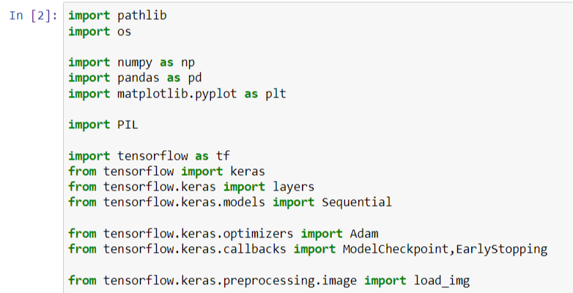
Importing Required Libraries

Slide 10
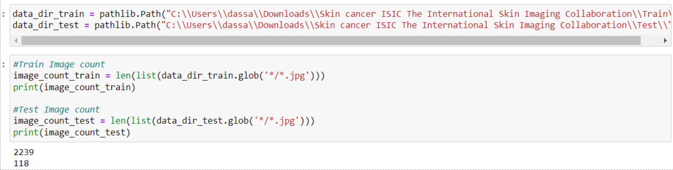
Load the Dataset

Slide 11
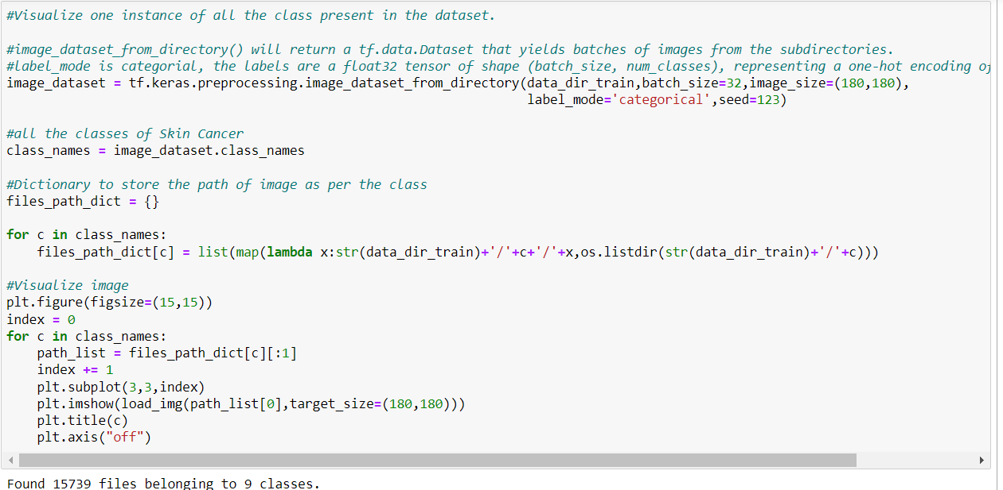
Visualize one instance of all the class present in the dataset

Slide 12
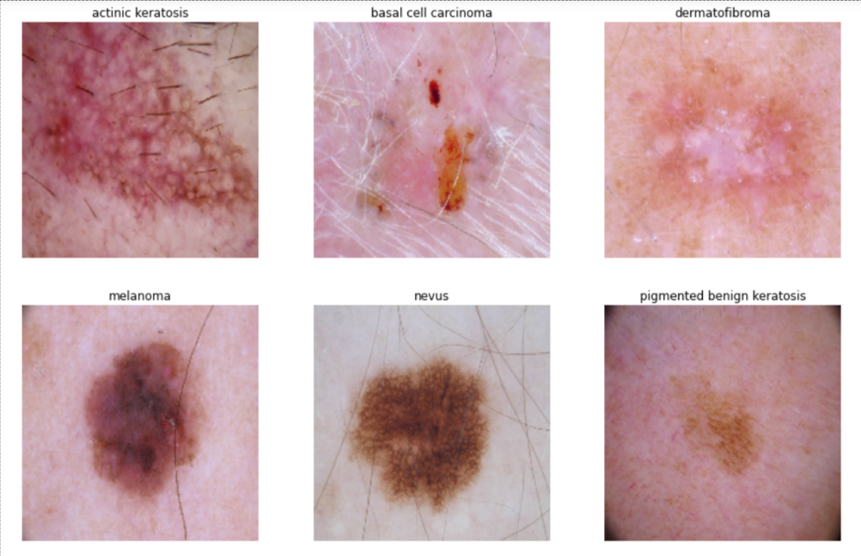
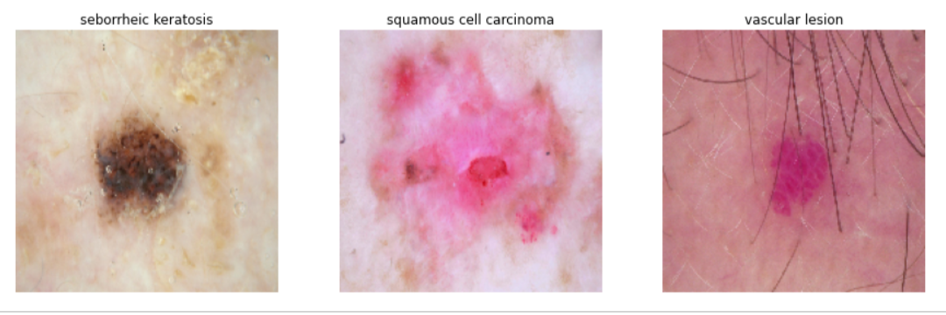

Slide 13
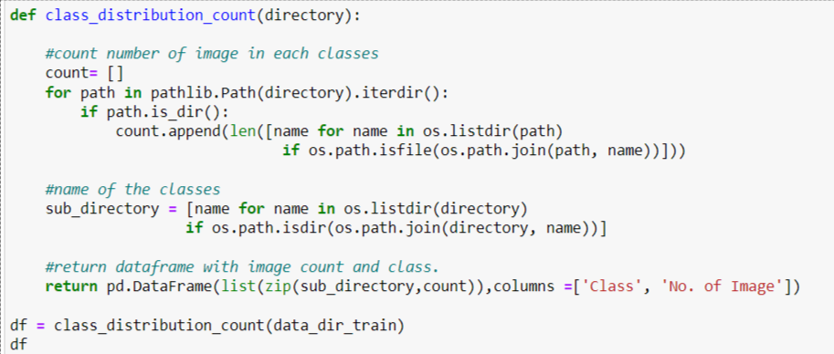
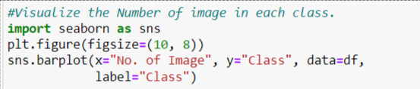
Visualize the training dataset

Slide 14
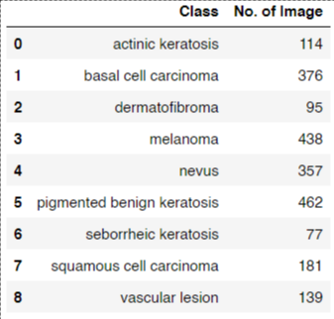
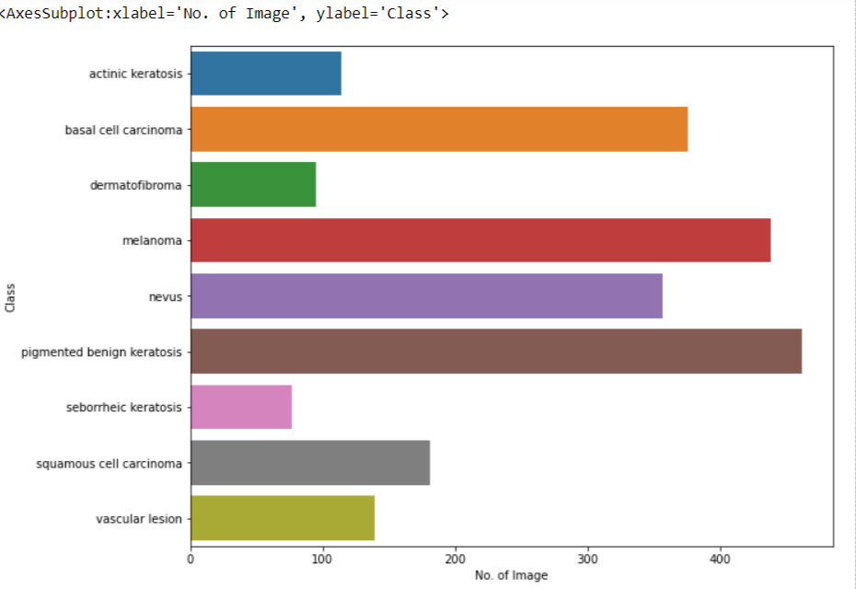

Slide 15
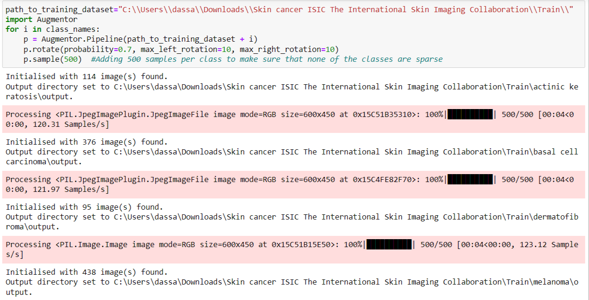
Augmentation

Slide 16
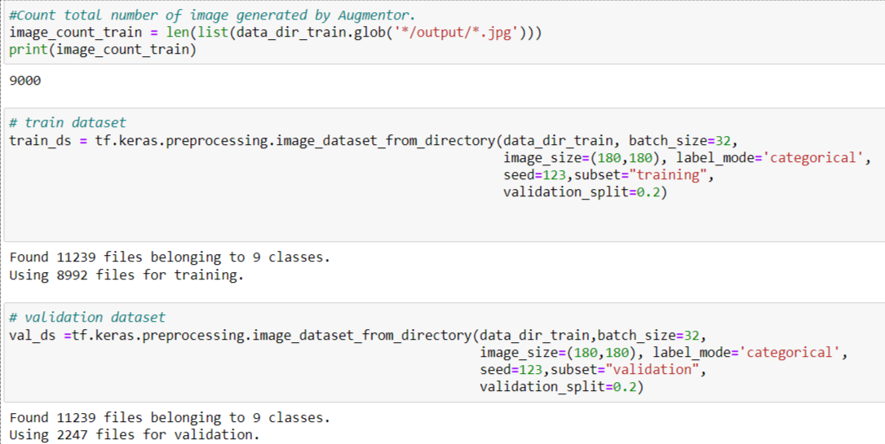
Dataset size after applying Augmentor

Slide 17
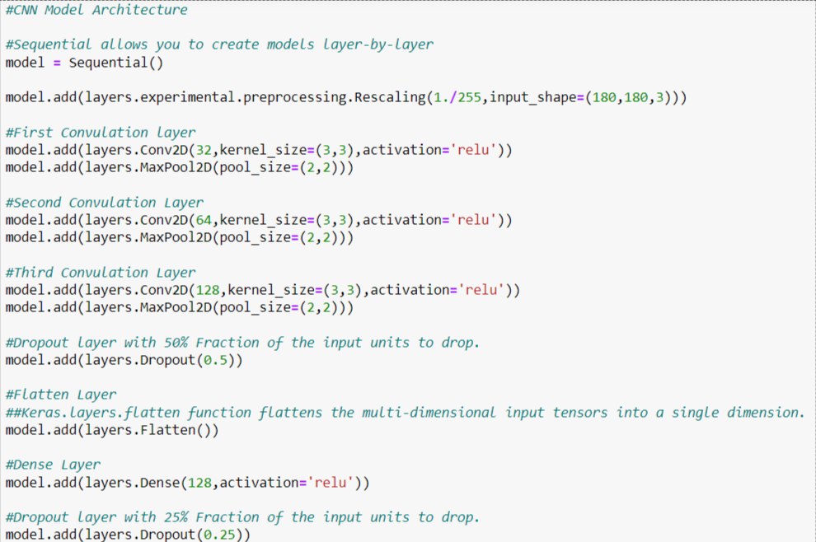
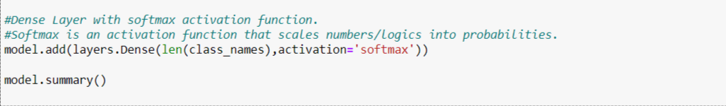
CNN Model Architecture

Slide 18
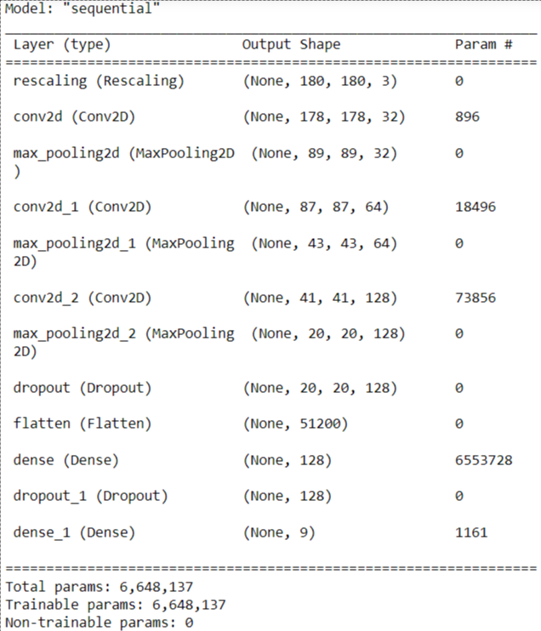

Slide 19
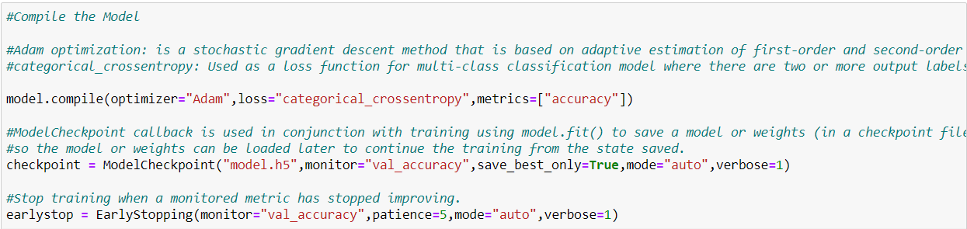
Compile the Model

Slide 20
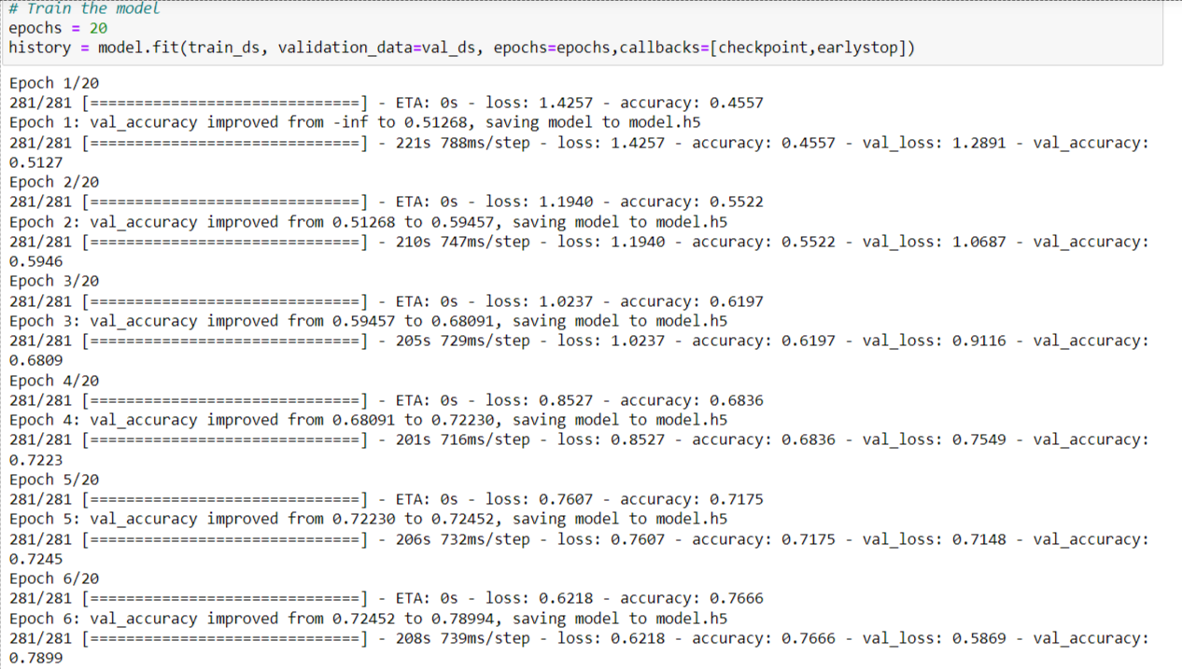
Train the model

Slide 21
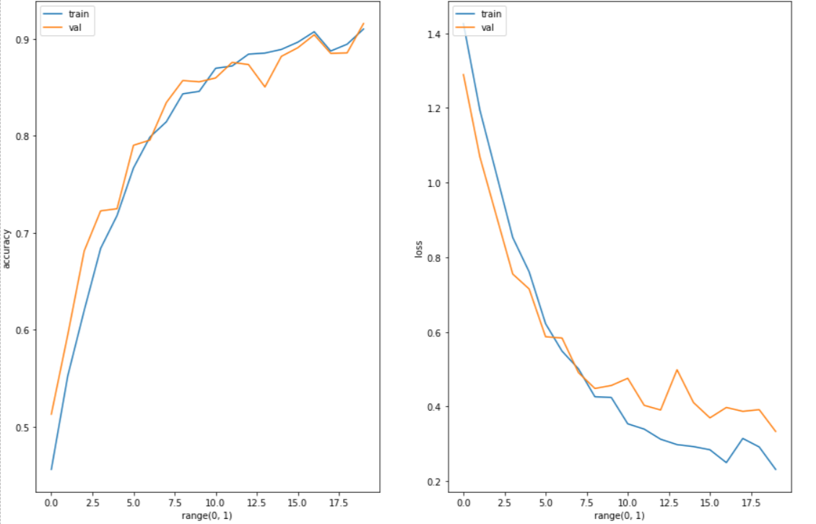
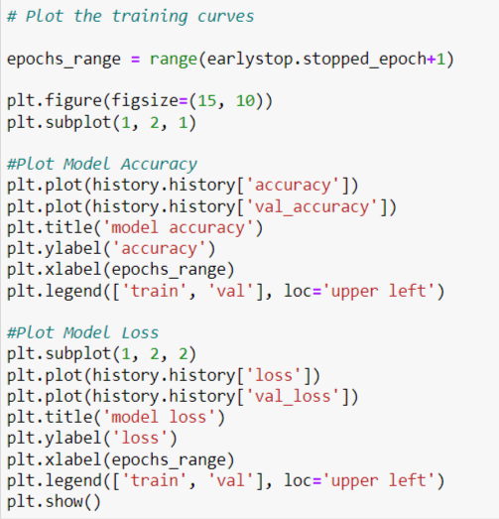
Plot the Training Curves

Slide 22
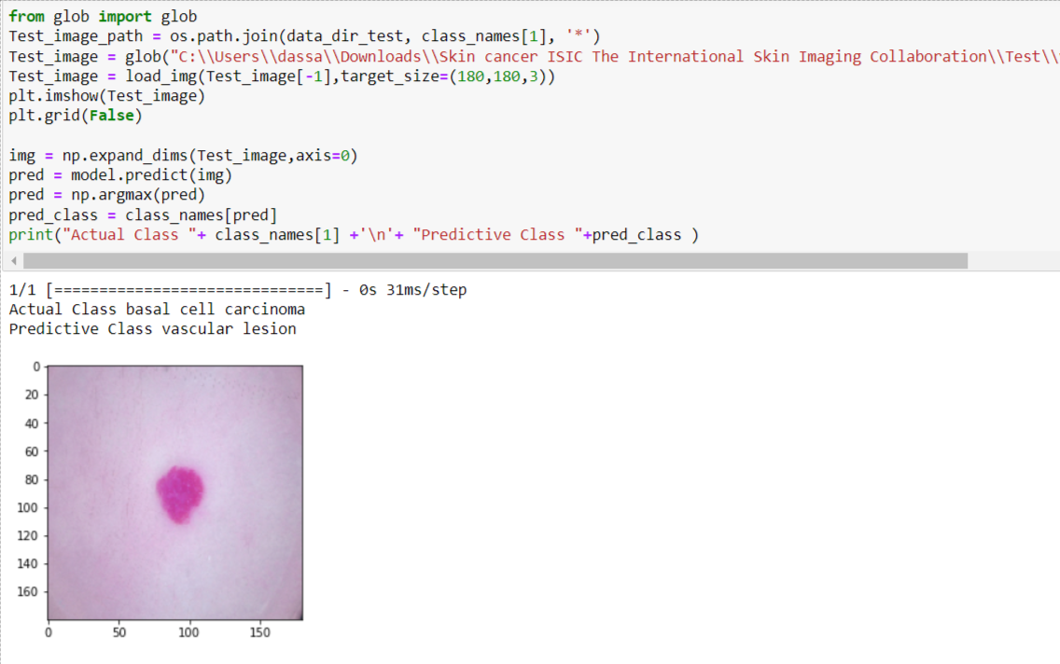
Model Prediction

Slide 23
Thank You

